Slide 1

A brand new EMC marketing opportunity
EMC+SIPI Online Symposium
August 7-11, 2017
An all new online conference targeting the EMC Society and EMC Symposium audiences
In conjunction with

Slide 2
What’s the Big Idea?
EMC+SIPI 2017 Online
A brand new EMC marketing opportunity
An EMC audience never offered before
First ever IEEE EMCS “digital” conference.
Live, global, online, “parallel”
Find new customers

Slide 3

Why does the marketplace need it?
  Suppliers connect with previously untapped EMC audiences
  2. training for engineers who cannot attend

Slide 4
.
What is the opportunity for
EMC marketers?
  AUDIENCES:
  2016 - 2016 EMC Symposium website - 15,800
  2016 Symposium - 1300
  EMC Society email - 10,300
  Total: 27,400
  TOOLS:
  Product Demonstrations
  Technical Presentations
  Whitepaper Marketing
  Sponsorships
  Advertising

Slide 5
How It Works
Some Technical Program broadcast live online
Also recorded
Online event attendees pay. Washington, DC Attendees
receive free
8 tracks. 6+ presentations.
EMC+SIPI ONLINE 2017 event sponsorships
Technical Presentations 45 mins)
Product Demos (15 mins) Speaker’s location anywhere
“Best in show” contest
“EMC Resources” whitepapers
Virtual Booth

Slide 6
Packages
EMC+SIPI ONLINE 2017 Event Sponsorships: $9,995 – $39,995
EMC+SIPI ONLINE 2017 Track Sponsorship: $14,995
Military & Aerospace, EMC Fundamentals, IoT, Wireless,
Signal Integrity, Power Integrity, Computational Electronics,
Information Security
Presentations:
Technical Presentation: $6,495
Product Demo Presentation: $3,000
  EMC Resources: $995
  Virtual Booth: $1,275
  “Best in Show” Contest: FREE

Slide 7
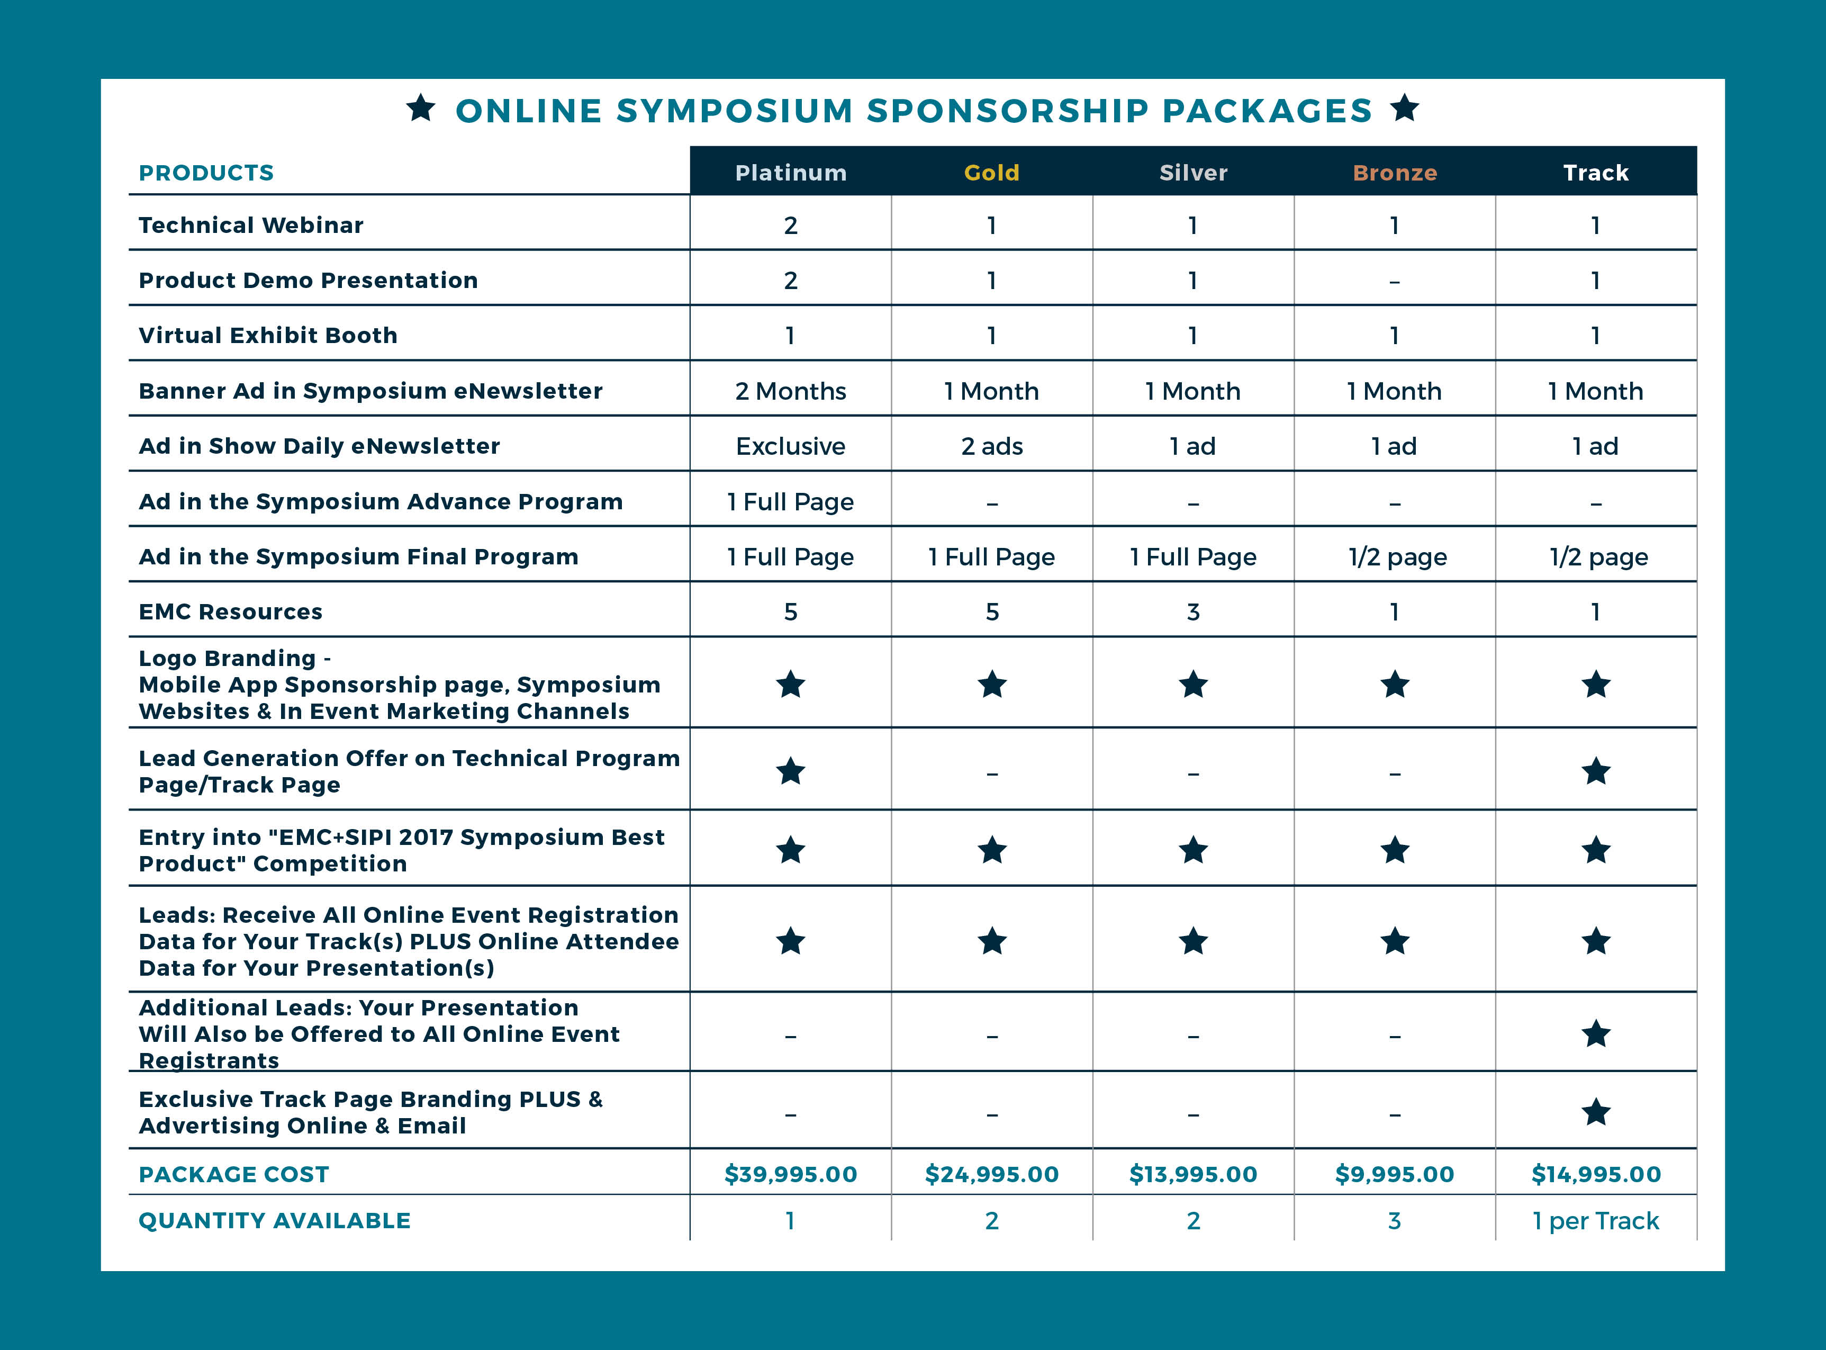

Slide 8
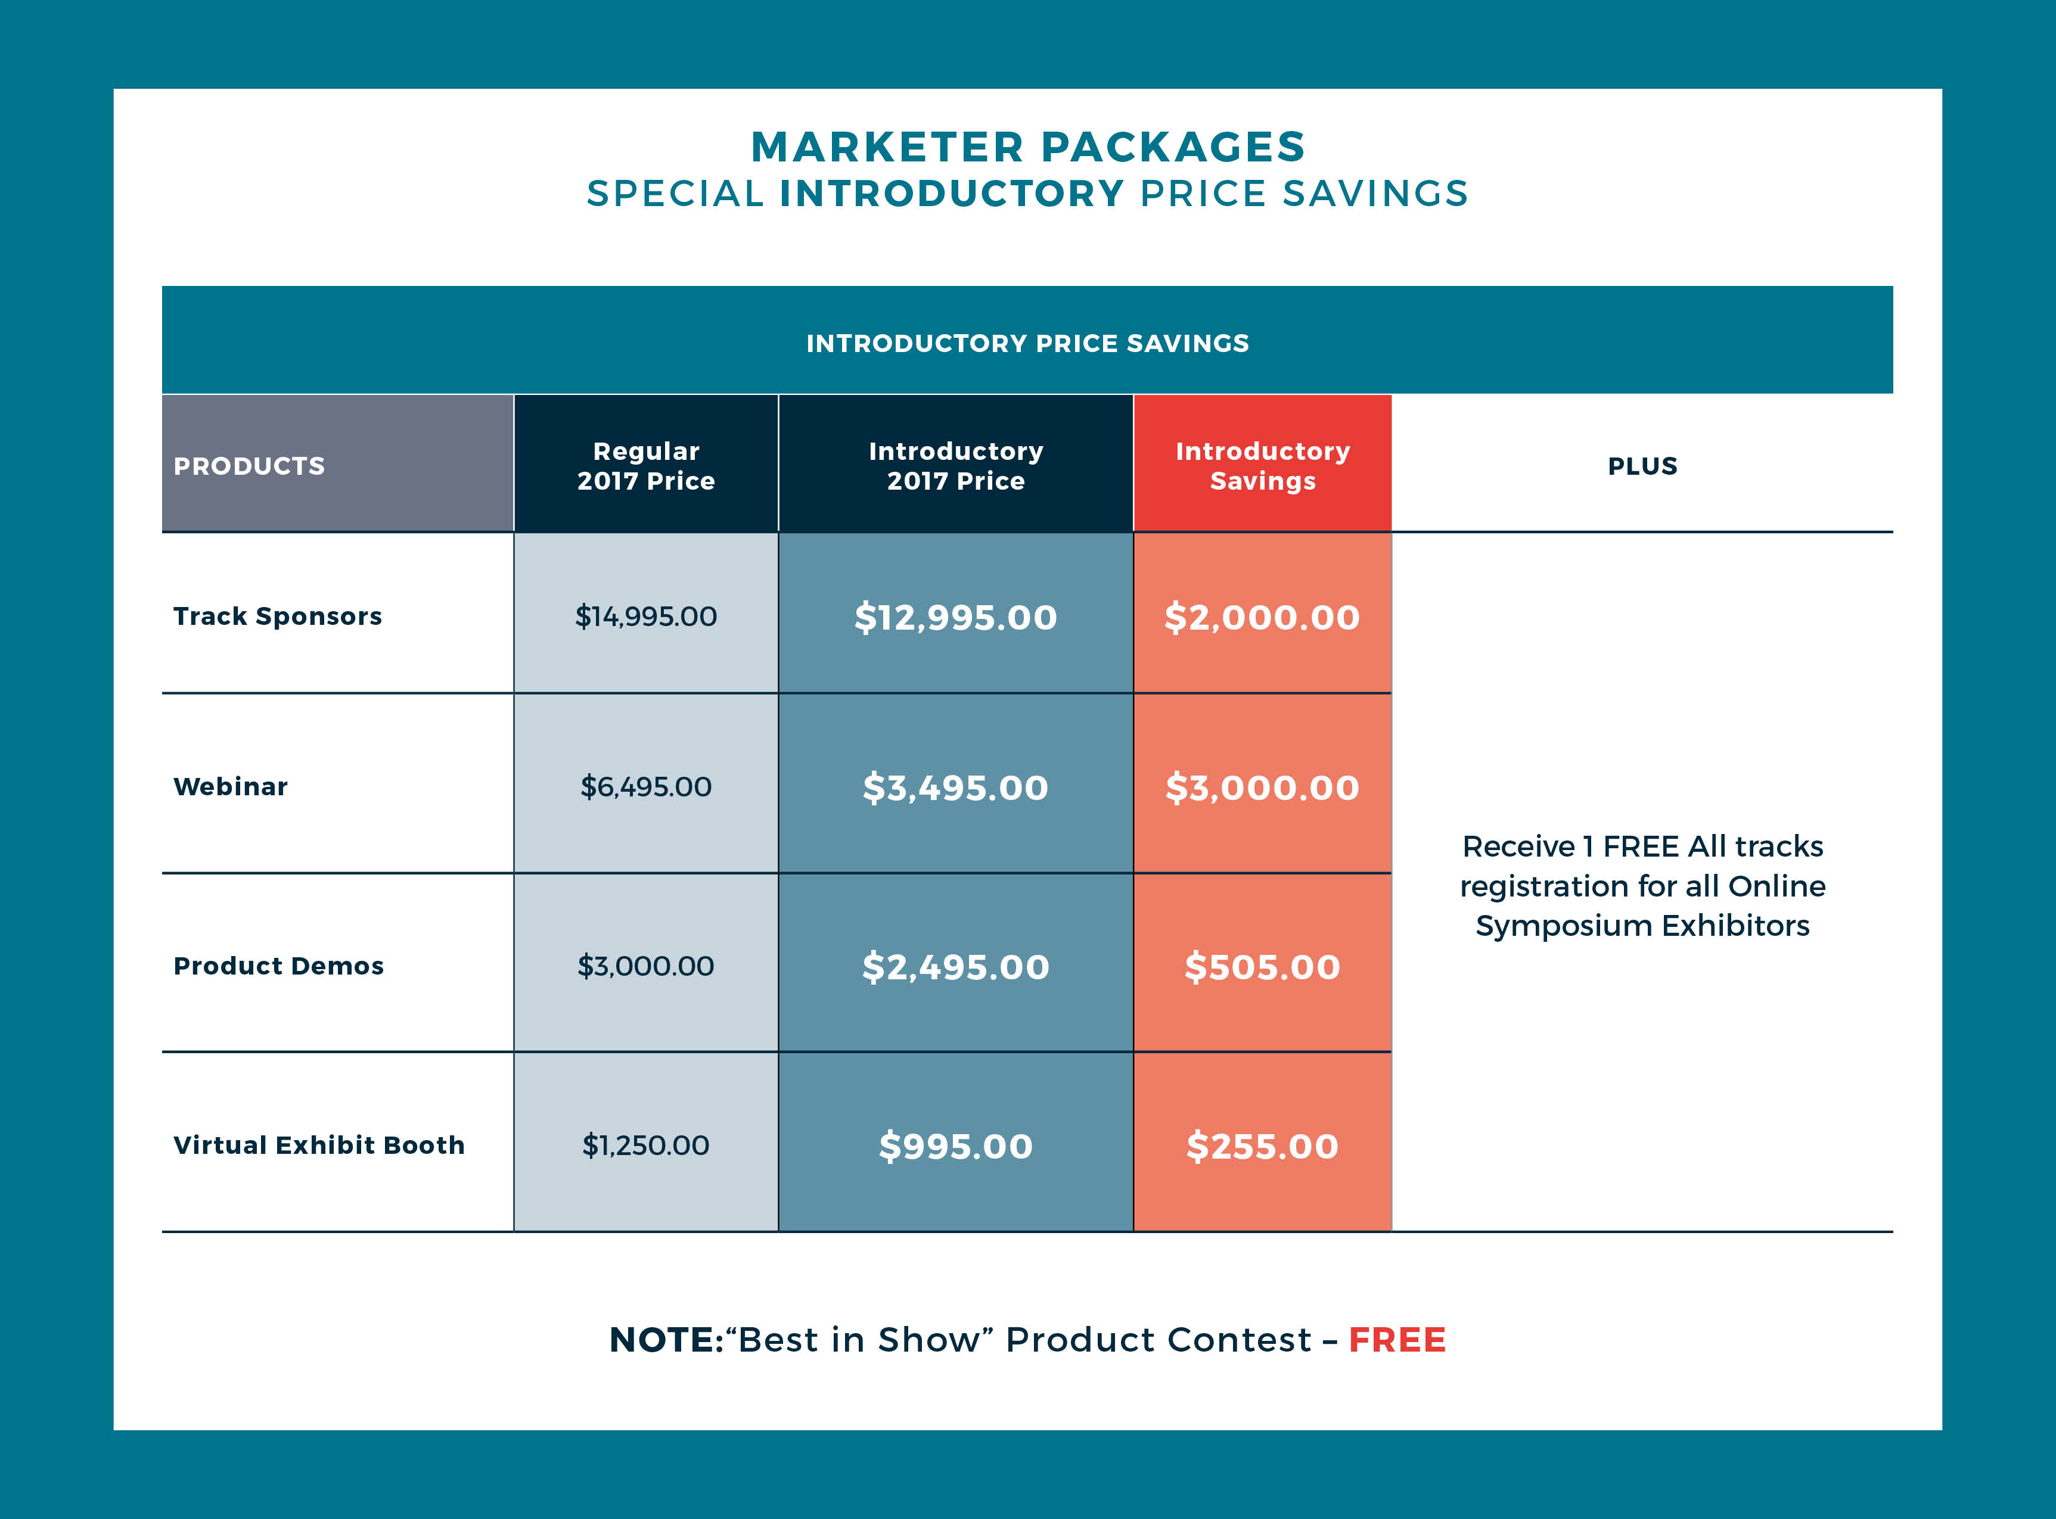

Slide 9
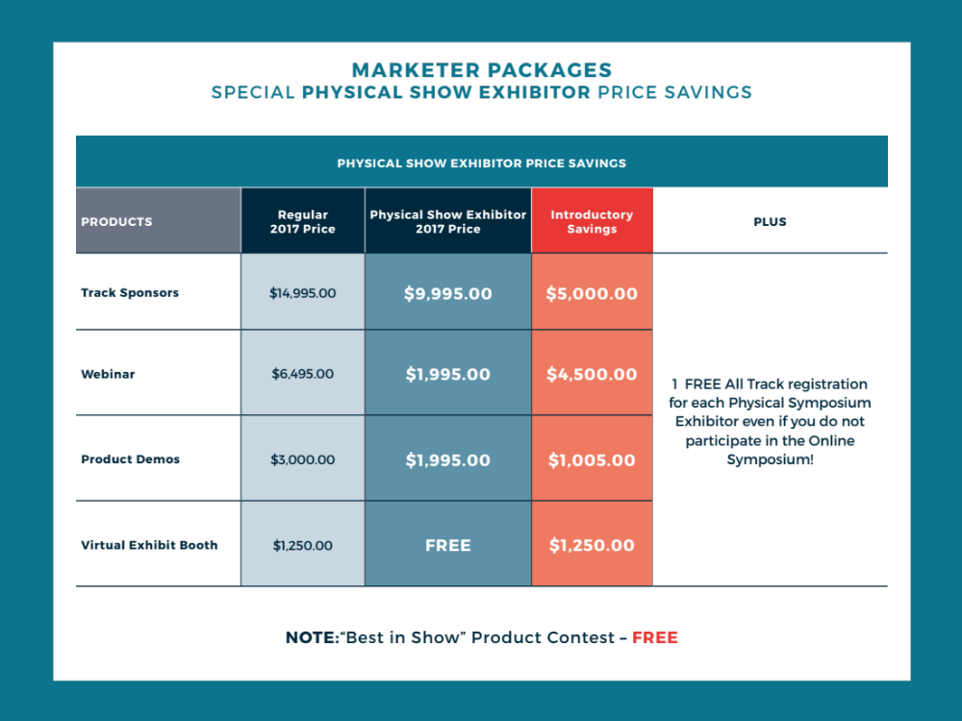

Slide 10
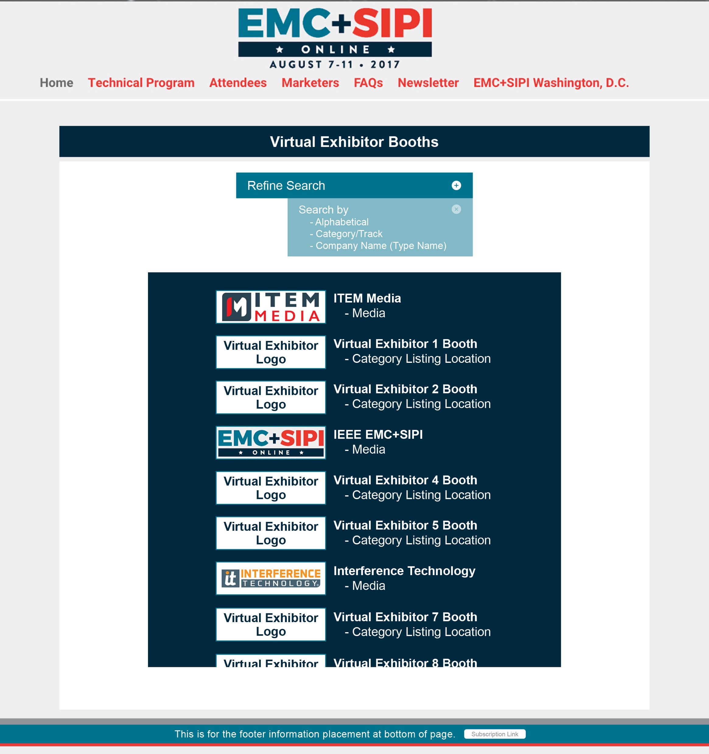
Online Symposium Virtual Booth
Virtual Booth Home Page
• Page contains a default alphabetical listing of all companies (with company logo) exhibiting in the virtual booth space
• Refine Search allows visitors the ability to search virtual booth exhibitors by:
- Alphabetical Order
- Company Name
- Category/Track

Slide 11

Online Symposium Virtual Booth
Virtual Booth Page
• Page contains Company logo and name
• 50-100 word descriptive paragraph about company, services, special offers or other points of interest
• Link (with image) to special offer/giveaway
• Virtual Business card submission
• Contact link with company (contact information and contact method designated by company)

Slide 12
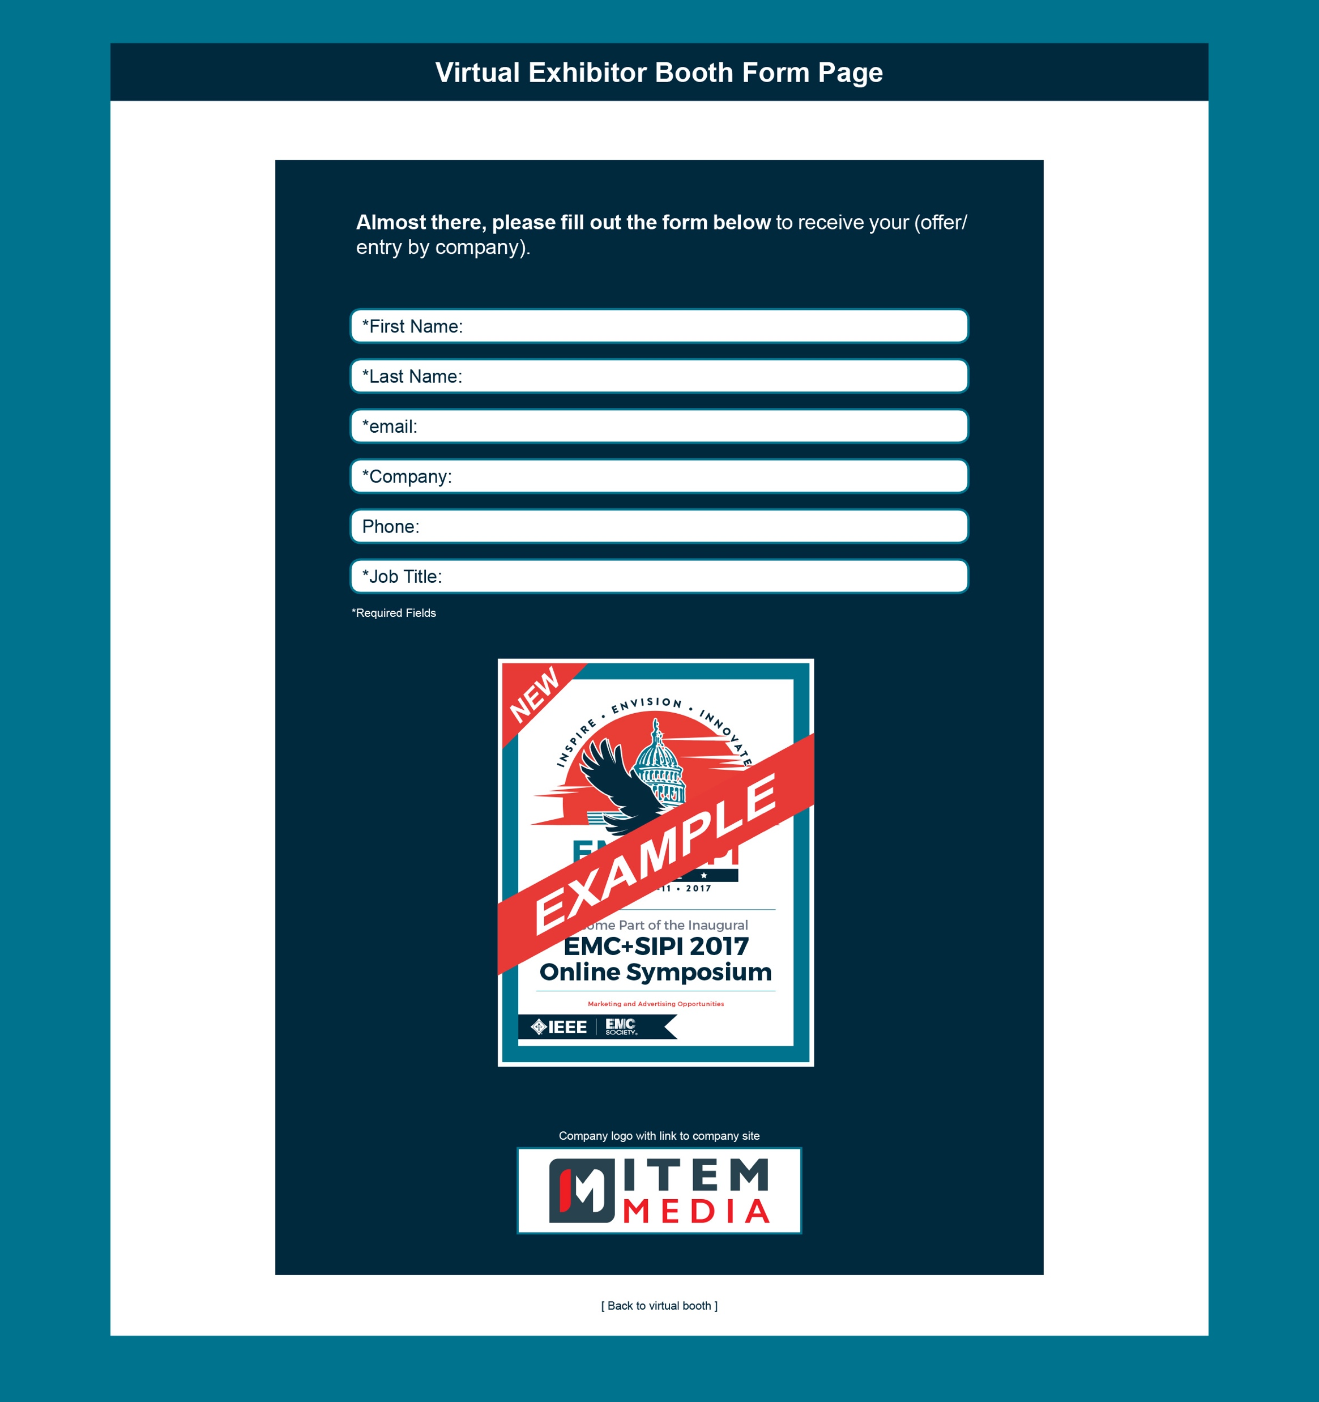
Online Symposium Virtual Booth
Offer Submission Form
• Lead information gathering form
• Form must be completed in order for prospect to access your offer or content
• Link to your website with logo

Slide 13
Thank you!
for more information please contact
Graham Kilshaw
e: graham@item.media
p: 610.382.5885
Jan Ward
e: jan@item.media
p: 610.382.5891
Todd Rodeghiero
e: todd@item.media
p: 610.382.5892

